Slide 1
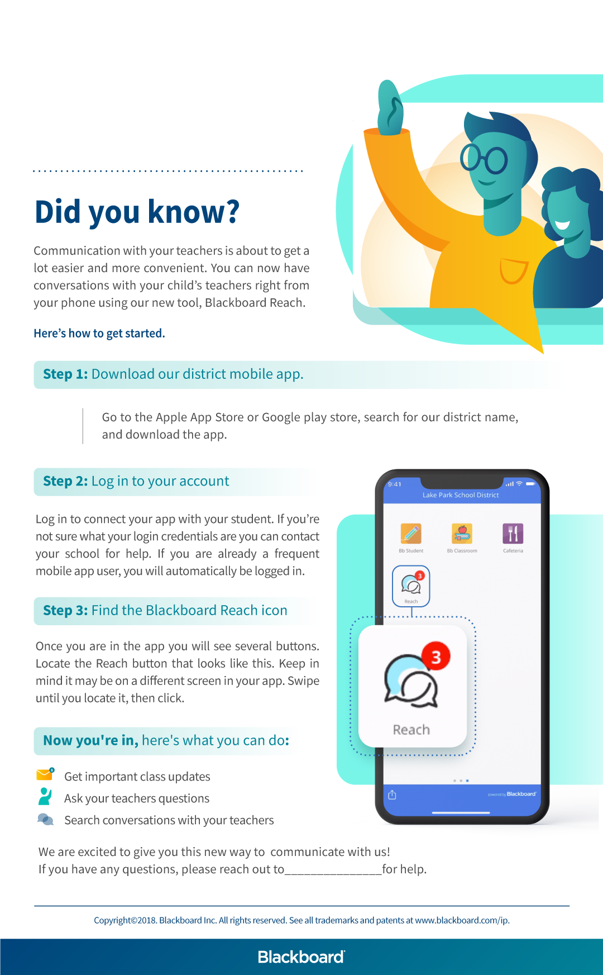
Add district or school logo here
Add app icon here
Add contact here

